Slide 1
Session-16
properties of covariance, Correlation of two random variables

Slide 2
Co-variance and Co-relation
Problems & Solutions

Slide 3

Covariance
Covariance signifies the direction of the linear relationship between the two variables. By direction we mean if the variables are directly proportional or inversely proportional to each other. (Increasing the value of one variable might have a positive or a negative impact on the value of the other variable
The values of covariance can be any number between the two opposite infinities. Also, it’s important to mention that covariance only measures how two variables change together, not the dependency of one variable on another one.
The value of covariance between 2 variables is achieved by taking the summation of the product of the differences from the means of the variables as follows:

Slide 4
Covariance
Xᵢ= Observation point of variable X
x̅= Mean of all observations(X)
Yᵢ= Observation point of variable Y
ȳ = Mean of all observations(Y)
n= Number of observations

Slide 5
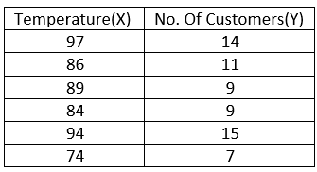
Example
Following data shows the number of customers with their corresponding temperature
Mean of X, x̅ = (97+86+89+84+94+74)/6 = 524/6= 87.333
Mean of Y, Ȳ = (14+11+9+9+15+7)/6 = 65/6= 10.833

Slide 6
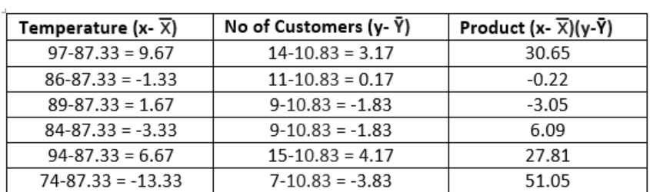
Contd
COV(x, y) = 112.33/(6–1) = 112.33/5 = 22.46

Slide 7
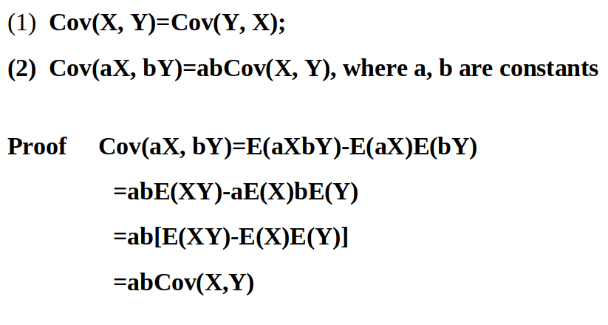
Properties of co-variance

Slide 8
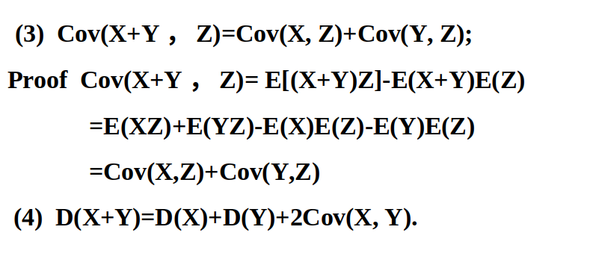
Cont...

Slide 9
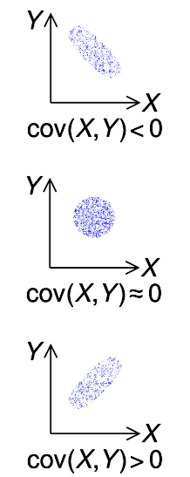
Cont...
covariance is only useful to find the direction of the relationship between two variables and not the magnitude.
the plots which help us understand how the covariance between two variables would look in different directions.

Slide 10
What is Correlation?
For example: Sales might increase if lot of money is spent on product marketing.
Why it is useful?
1. If two variables are closely correlated, then we can predict one variable from the other.
2. Correlation plays a vital role in locating the important variables on which other variables depend.
3. It’s used as the foundation for various modeling techniques.
4. Proper correlation analysis leads to better understanding of data.
5. Correlation contribute towards the understanding of causal relationship(if any).

Slide 11
Corelation
Correlation analysis is a method of statistical evaluation used to study the strength of a relationship between two, numerically measured, continuous variables.
It not only shows the kind of relation (in terms of direction) but also how strong the relationship is. Thus, we can say the correlation values have standardized notions, whereas the covariance values are not standardized and cannot be used to compare how strong or weak the relationship is because the magnitude has no direct significance. It can assume values from -1 to +1.
To determine whether the covariance of the two variables is large or small, we need to assess it relative to the standard deviations of the two variables.

Slide 12
Correlation
Correlation, statistical technique which determines how one variables moves/changes in relation with the other variable.
It gives us the idea about the degree of the relationship of the two variables.
It’s a bi-variate analysis measure which describes the association between different variables.
In most of the business it’s useful to express one subject in terms of its relationship with others.

Slide 13
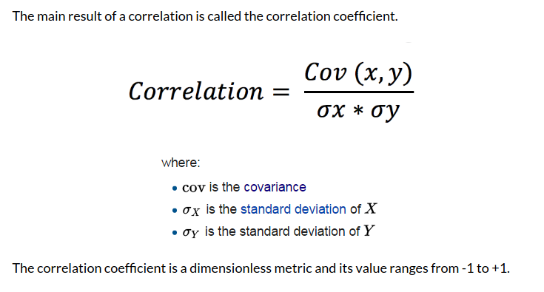
Cont...

Slide 14
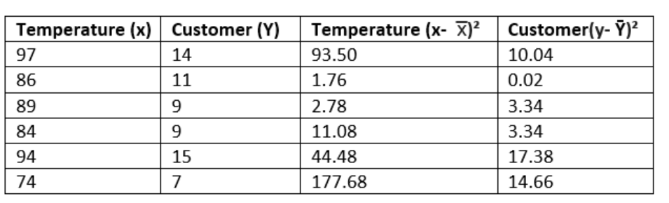
Correlation coefficient
COV(x, y) = covariance of the variables x and y σx = sample standard deviation of variable x σy = sample standard deviation of variable y

Slide 15
Correlation
OV(x, y) = 22.46
σx = 331.28/5=66.25= 8.13
σy = 48.78/5=9.75=3.1
correlation = 22.46/(8.13x 3.1)= 22.46/25.20 =0.8
0.8 shows that strength of the correlation between temperature and number of customers is very strong

Slide 16
Ames housing dataset available on Kaggle.com. This dataset contains over 30 features that potentially affect the variance in sales price, our y-variable.
import pandas as pd import numpy as npimport seaborn as sns import matplotlib.pyplot as plt

Slide 17
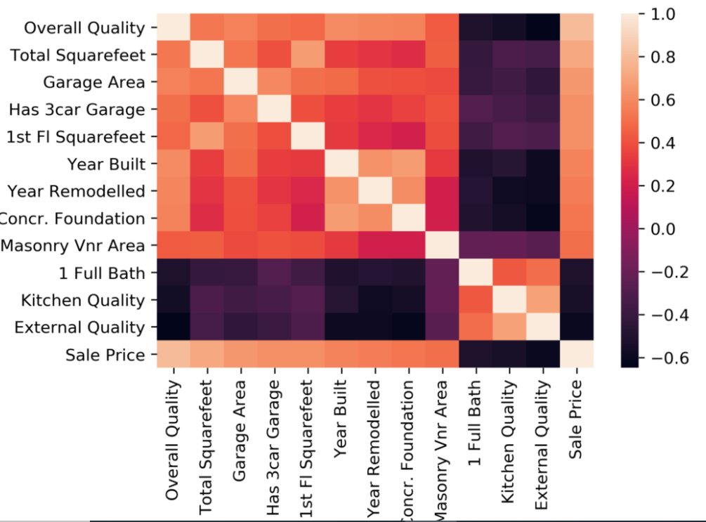
Dataframe.corr()
sns.heatmap(dataframe.corr());

Slide 18
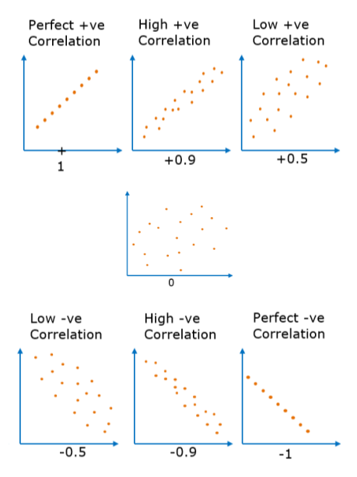
Cont...
Covariance and correlation are related to each other, in the sense that covariance determines the type of interaction between two variables, while correlation determines the direction as well as the strength of the relationship between two variables.

